Slide 1
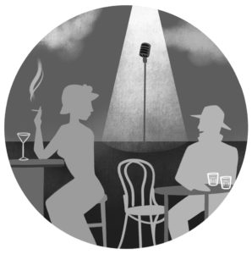
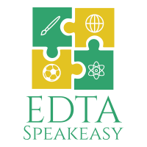
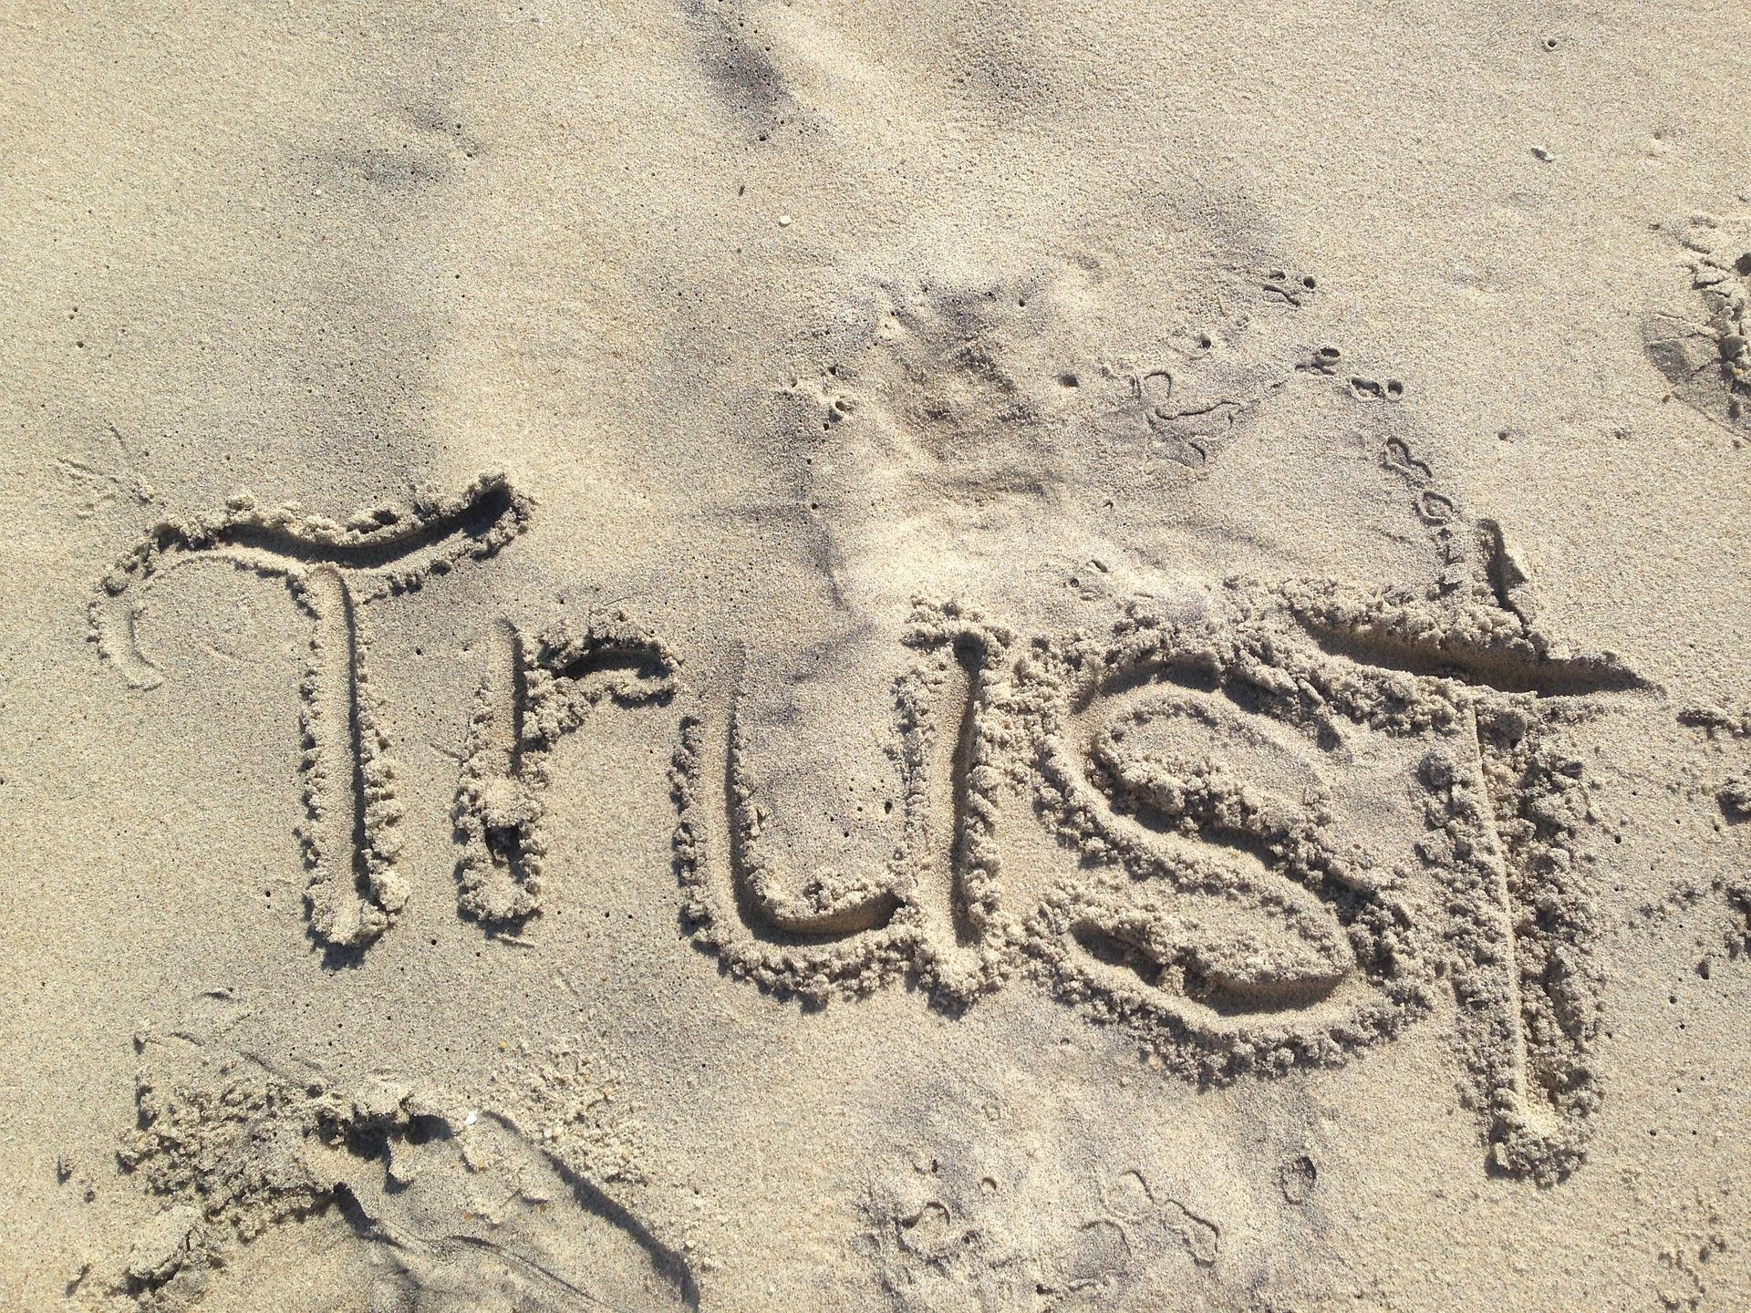
EDTA Speakeasy
How and why trust matters in academic development
Celia Popovic and Fiona Smart invite you to the Sept 2023 EDTA Speakeasy and it is an EDTA first!!
To accommodate different time zones, the session will run twice:
Tuesday, 12 September 2023, 14:00 UTC (GMT) Click here for the time in your country
Wednesday, 13 September 2023, 20:00 UTC (GMT) Click here for the time in your country
To register: email Fiona at FMSmart@outlook.com - do tell her which Speakeasy you will join ☺
Our provocateurs are: Dr Kathryn Sutherland, Victoria University of Wellington; Dr Gabriela Pleschová, Comenius University Bratislava; Dr Rachel Forsyth, Lund University; Professor Peter Felten, Elon University; and Dr Julie Timmermans, University of Otago The provocation is … We often take as a given that trust is essential for effective learning and teaching relationships (Beltrano et al., 2021; Carless, 2012; Felten & Lambert, 2020; Pedersen et al., 2022). However, scholars regularly note that many of the claims about trust in higher education are based more on intuition than research (Tierney, 2006; Hagenaur & Volet, 2014). Might the same be the case in educational development? We have an excellent guide on building trusting rapport in our work based on interviews with developers (West et al., 2017), thoughtful studies on trustful conversations in faculty and academic development (Cook-Sather et al, 2021; Simon & Pleschová 2021) and new conceptual articles exploring the nature of credibility and trustworthiness in educational development (Little & Green, 2022). What more should we be asking about trust in practice and in context? How do identities and cultures influence trust in educational development interactions? Does compulsory or voluntary participation in our programmes influence whether and how trust develops? Will people perhaps distrust us if our work addresses primarily institutional rather than individual priorities (Roxå & Mårtensson, 2017)?
Speakeasy – an illicit thinking den!
Where we encourage debate and thinking outside the rules.

