Slide 1
To play or not to play – a degree isn’t meant to be fun
Roger Saunders
roger.saunders@dmu.ac.uk

Slide 2
In the beginning…

Slide 3
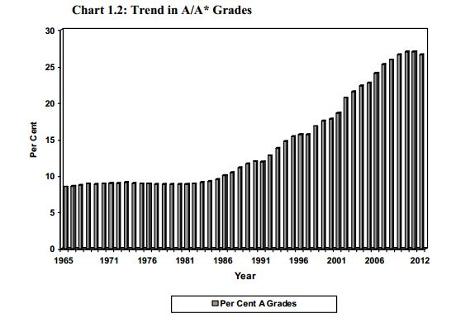
Context
The expansion of higher education along with an increased focus on metrics has led to the corruption of Higher Education
Expansion has led to weaker students, masked by grade inflation that ultimately led to the introduction of A*

Slide 4
Context
The expansion of higher education along with an increased focus on metrics has led to the corruption of Higher Education
Metrics have led to an increased focus on attainment and satisfaction that have fuelled grade inflation (increase in firsts and ‘good’ degrees) and a focus on student perception of ‘experience’.

Slide 5
Attainment
The proportion of students getting “good honours” – a First or 2:1 – has leapt from 47 to 79 per cent: at 13 universities, more than 90 per cent of students were given at least a 2:1 last year. And Oxbridge is leading the charge: 96 to 99 per cent of its English, history and languages students get “good honours”.
Notes:
https://www.newstatesman.com/politics/2019/08/the-great-university-con-how-the-british-degree-lost-its-value

Slide 6
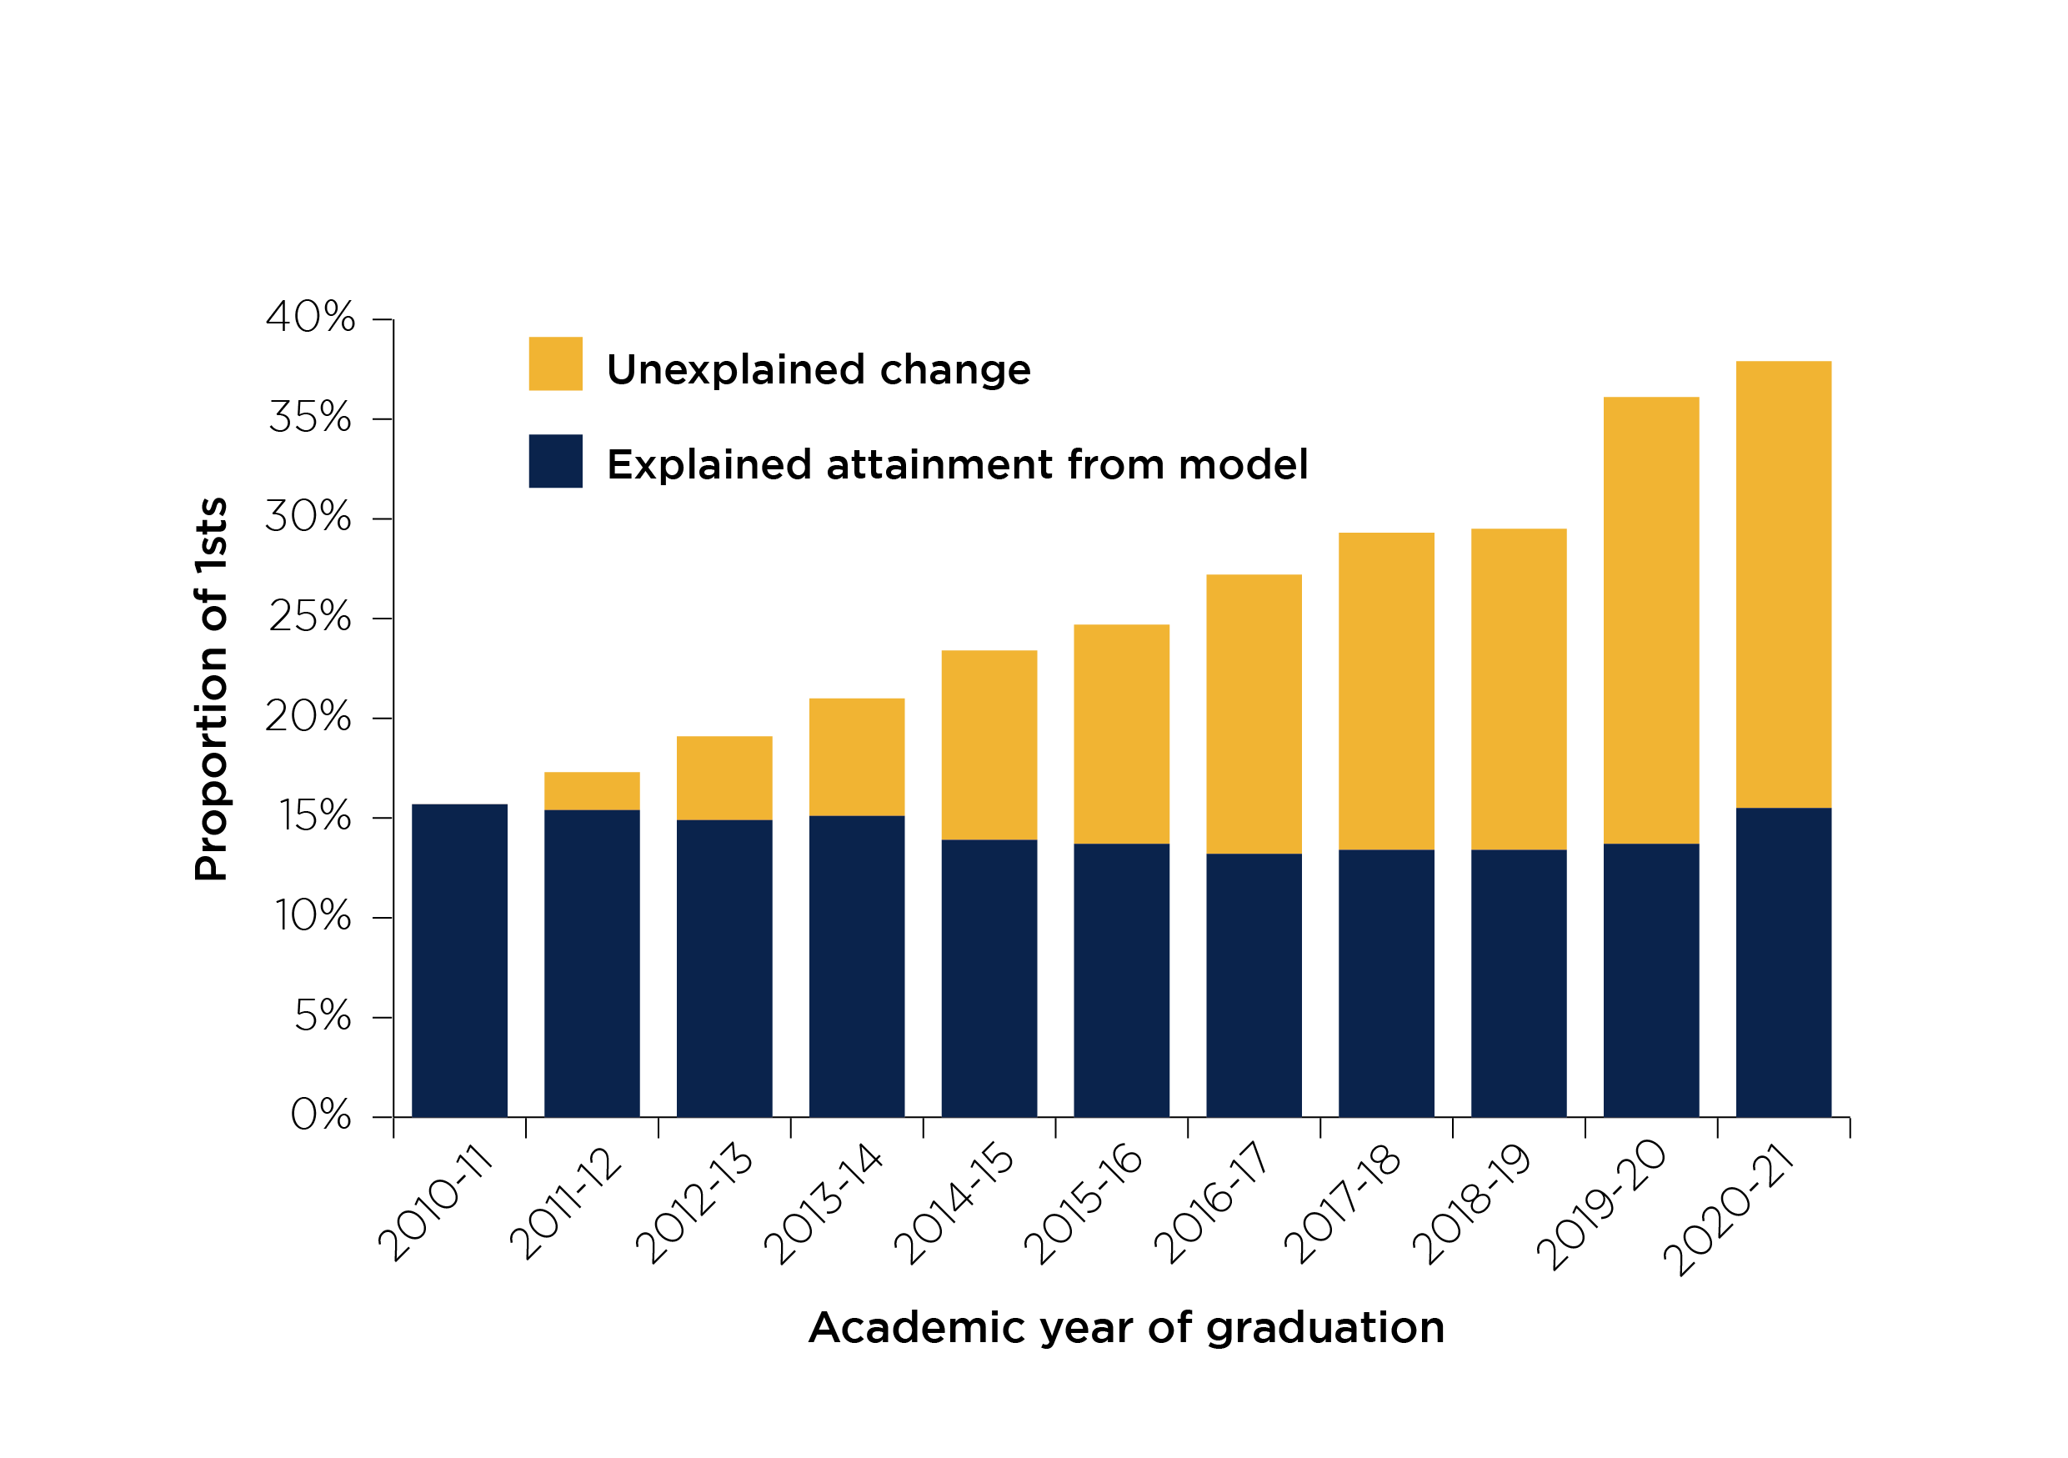
Attainment
Notes:
https://www.officeforstudents.org.uk/publications/maintaining-the-credibility-of-degrees/#section4c

Slide 7
Employability
“An overwhelming majority of businesses (79%) regard a 2:1 undergraduate degree (or above) as a good measure of academic ability”
Notes:
https://www.cbi.org.uk/media/1171/cbi-educating-for-the-modern-world.pdf

Slide 8
Context
The expansion of higher education along with an increased focus on metrics has led to the corruption of Higher Education
Student ‘experience’ is about pressure – fewer assessments, more explicit instructions, assessment focused content, less out of class activities/engagement, less reading.

Slide 9
Engagement
“The new higher education regulator, the Office for Students, has pledged to pay close attention to student retention and success.”
Notes:
https://www.theguardian.com/education/2018/mar/08/university-drop-out-rates-uk-rise-third-year

Slide 10
Reading (why they don’t)
Language deficit
Time constraints
Lack of motivation
Underestimating the importance
Notes:
https://theconversation.com/up-to-80-of-uni-students-dont-read-their-assigned-readings-here-are-6-helpful-tips-for-teachers-165952
https://files.eric.ed.gov/fulltext/EJ1135576.pdf

Slide 11
Impact of social media
Lower literacy
Increased stress
Narrow knowledge
Incorrect knowledge

Slide 12
Play in learning has a place
Notes:
https://www.unicef.org/sites/default/files/2018-12/UNICEF-Lego-Foundation-Learning-through-Play.pdf

Slide 13
Students and play
“Students are grown-ups; they’re adults. They don’t want to be treated like nursery school children anymore, or infant school, or even primary school children.”
“shifting the students’ focus away from screens, notes and the lecturer”
Notes:
https://www.timeshighereducation.com/campus/playful-learning-how-get-started
https://www.timeshighereducation.com/campus/teaching-lego-using-plastic-bricks-encourage-play-and-interaction-class

Slide 14
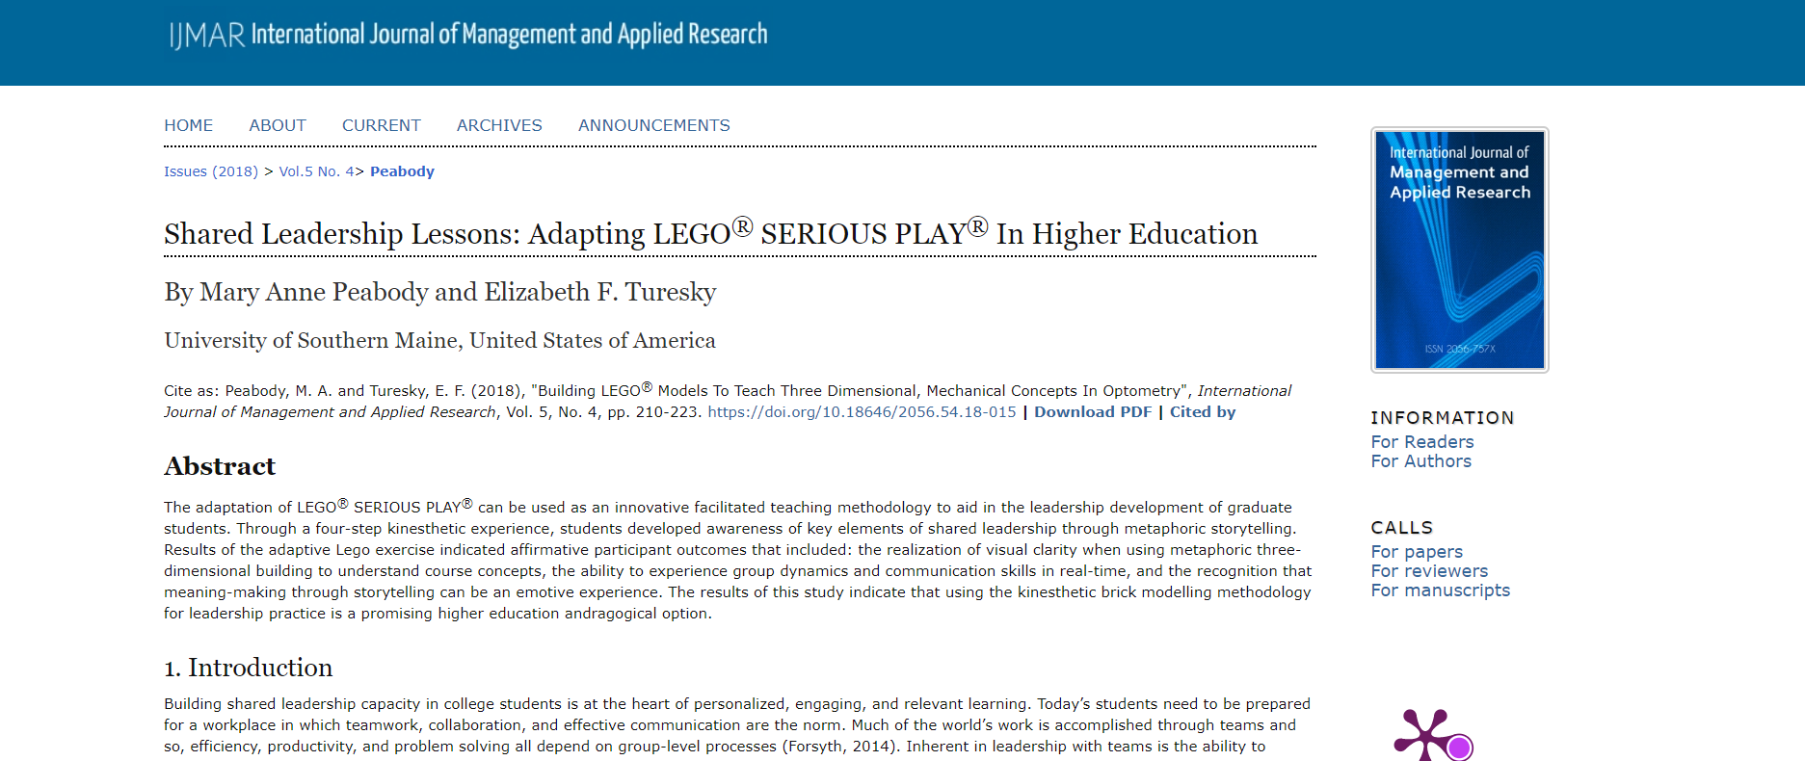
Play is wide spread in HE
Notes:
https://www.ijmar.org/v5n4/18-015.html

Slide 15
Gamification (play)
Can take longer to prepare
Can cost more in terms of resources
Can take longer to explain/different requirements
Can take longer to deliver
May not meet UDL requirements
Needs more structured reflection
Needs to be aligned with assessment
Can cause issues between different modules

Slide 16
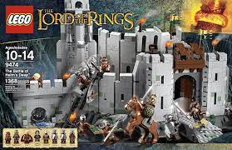
Lego
1990s Decline
2007
2012
2014
Notes:
https://www.lego.com/en-gb/themes/serious-play/background

Slide 17
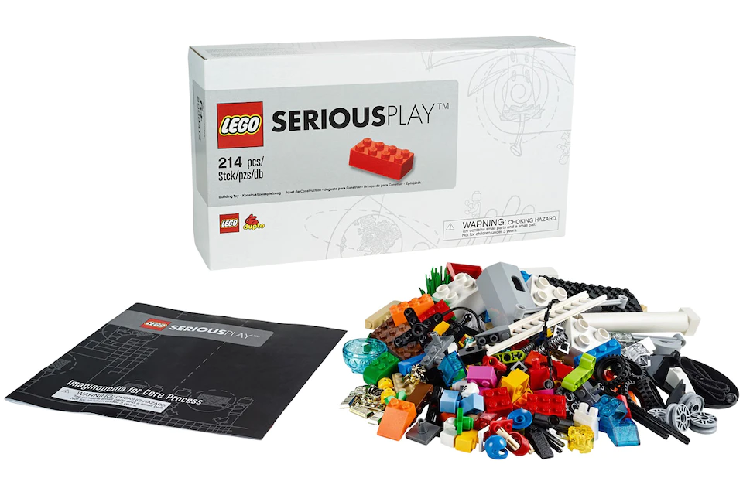
Lego Serious Play
1996
2002
£25-50
£1500-£2000
Notes:
https://www.lego.com/en-gb/themes/serious-play/background

Slide 18
Playful learning
Creates an expectation
Doesn’t increase reading skills
Reduces time on task
Reduces the value of the academic to a facilitator (game creator)
Makes it harder for students to see the ‘value’ of HE

Slide 19
Thank you
Roger Saunders
roger.saunders@dmu.ac.uk

