Slide 1
The case for using
Threshold Concepts for Learning Design
By Virna Rossi
Twitter @VirnaRossi
Speakeasy September 2021

Slide 2
Overview of the presentation
In our time together…
Firstly I’ll discuss why threshold concepts (TCs) support inclusive learning design better than learning outcomes
Secondly I’ll share the early results of my action research: the pilot of my own innovative ‘roots to shoots’ approach to inclusive, creative learning design using TCs as a main content organising principle
Finally we can all interact with a crowdsourced Jamboard about TCs for novice teachers

Slide 3

Putting people first... How are you feeling today?
In the chat, indicate the best match/es...
How are you? | A | B | C | D | E | F
1
2
3
4

Slide 4
Why use TCs for learning design
TCs can both be seen as gateways into the disciplines and help identify typical bottlenecks where students can get stuck. They tend to represent the gems of the curriculum. Because of their transformative power, they affect who the students become.

Slide 5
Benefits of TCs rather than LOs for learning design
Identifying likely/perceived TCs for learning design is a more useful starting point than formulating LOs because:
the focus shifts onto the BIG ideas
it means starting from the ‘centre’ of learning
we tackle the ‘tricky concepts’ at learning design stage
it helps focus on the transformative power of ‘learning to become’, rather than focusing on pre-determined conditions/skills
it helps students uncover the hidden curriculum
Where necessary, TCs can eventually be used to formulate LOs for course documentation and QA purposes.

Slide 6
My action research on TCs for learning design
Sept 2019 – I used TCs for learning design on the PGCert course. I decided to develop my own TCs learning design tool
2020 – I started writing my book on inclusive learning design (publisher: Routledge, due in Spring 2022) – the learning design tool linked to it features TCs as main content organising principle
May/Jun 2021 – I collaboratively created the first prototype of the learning design tool. First pilot and lessons learnt
Autumn 2021 – Pilot of second prototype – early findings and impact in my upcoming book

Slide 7
The working group for the learning design tool

Slide 8
The I.N.C.L.U.S.I.V.E learning design tool
I created a tool teachers can use through a collaborative workshop to design learning.
To visually represent the phases and process of inclusive learning design, I use the metaphor of a tree.
The roots are the values.
Then it’s ‘roots to shoots’, to get to the 3 branches of:
Context, Content and Assessment.

Slide 9
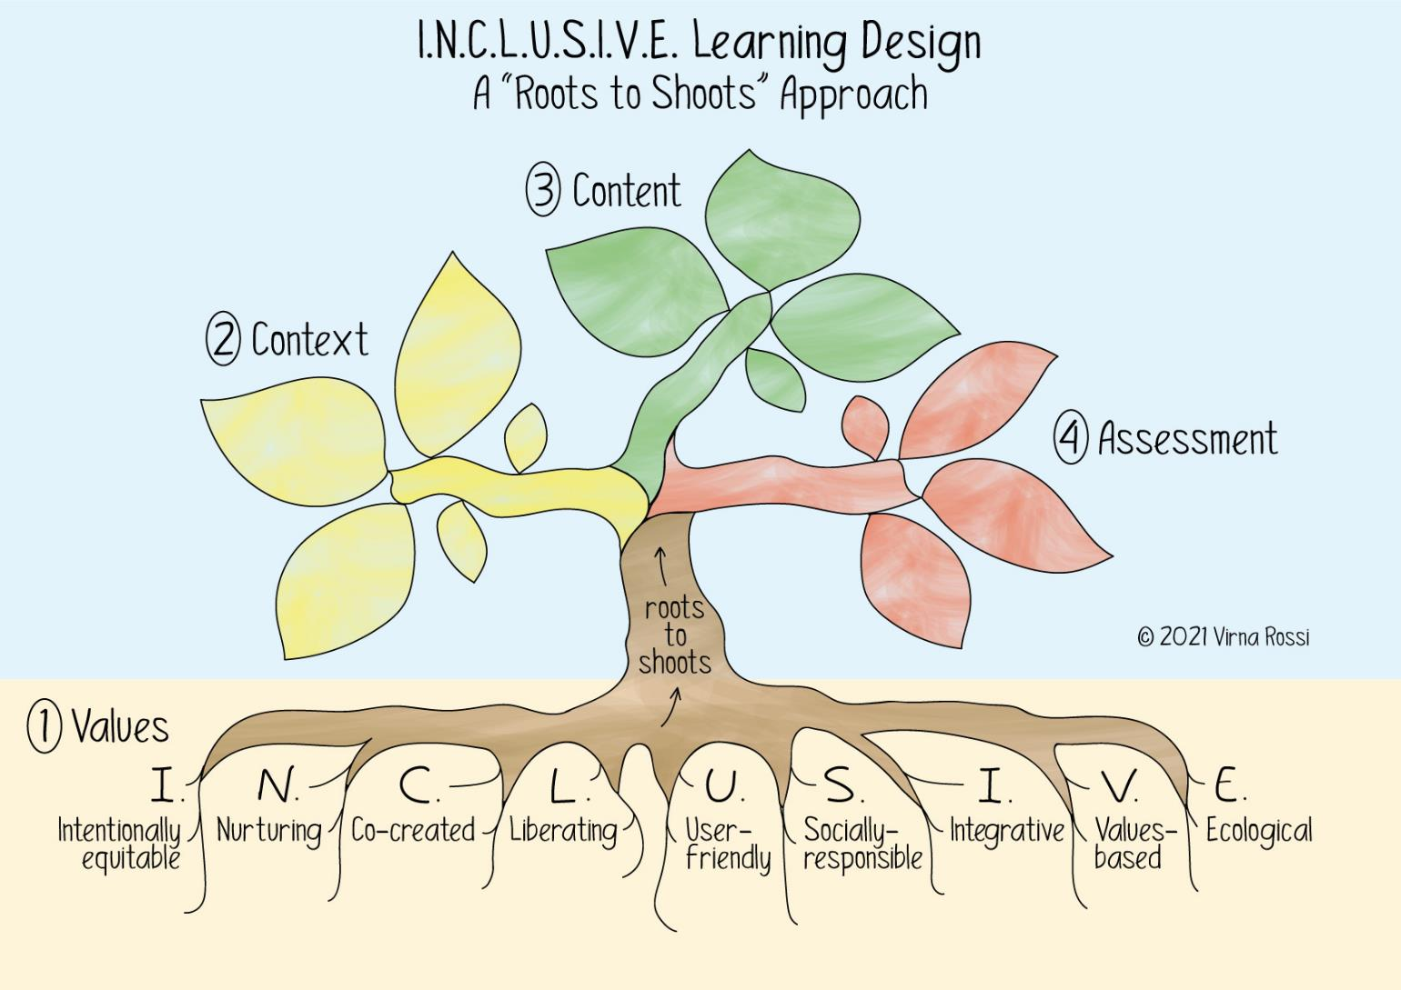

Slide 10
Some possible definitions
What is inclusivity?
My view of inclusivity it is that of a social model, more akin to an ethos or a value than a method. It aims to grant each student, with their intersectional diversity, full membership to education, to enable them to gain full membership to society.
What is learning design?
‘Learning design is a process that encompasses the thoughtful planning of a learner’s journey, constructing that journey, delivering it in some form and, finally, reflecting and reviewing on the outcomes’ – Andres Ordorica

Slide 11
Learning Design workshop – part 1
Participants use the learning design tool in a two-part workshop.
Before part 1, by means of a Padlet I send participants research around the three frameworks I use in the design tool: UDL, TCs and Flipped Learning
In part 1, participants: write an ‘elevator pitch’ of their course; create anticipated student personas; identify their own values (the roots of the tree) and discuss in groups key ideas linked to the three branches: context (setup and engagement), content (input and practice) and assessment (outputs and feedback). As part of the ‘content’ branch, they identify TCs for their course.

Slide 12
Learning Design workshop – part 2
Between part 1 and part 2, participants identify and invite other stakeholders to join them for part 2, to form a diverse cluster to collaboratively design learning
In part 2, participants, within their collaborative and varied clusters develop the storyboard of the student journey, starting by further articulating TCs for each phase of their course.
They use a Jamboard as a digital, collaborative space to develop the storyboard

Slide 13
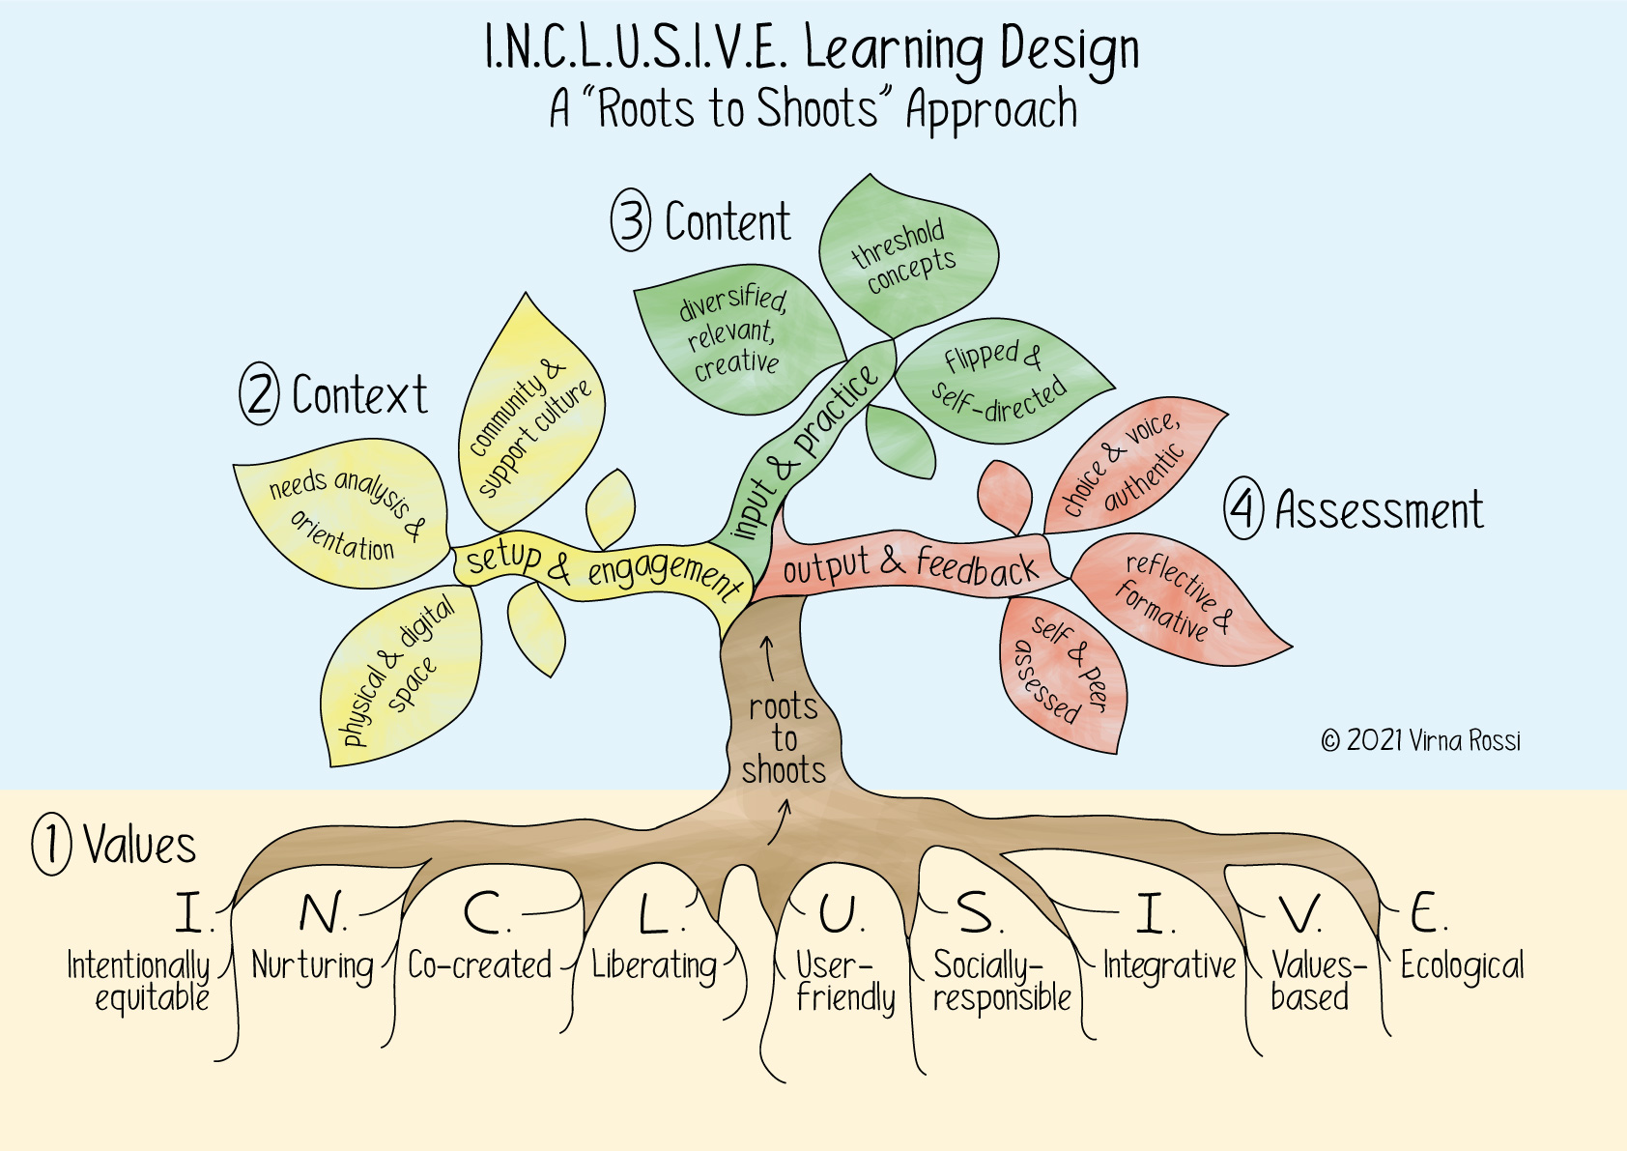
The I.N.C.L.U.S.I.V.E learning design tree: the place of TCs

Slide 14
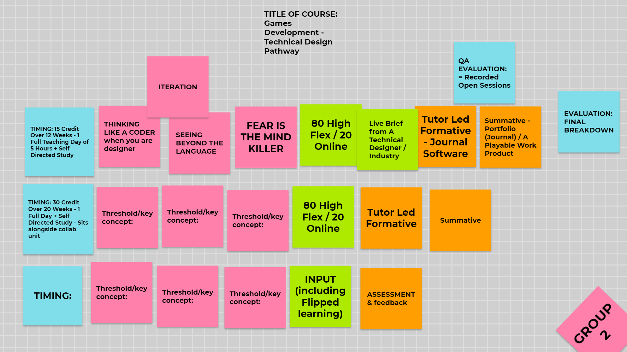
Learning Design workshop – example

Slide 15
Early findings – What worked well
The tree analogy and branches supported the learning design well
The Jamboard was a very effective digital tool for collaborative design
Teachers responded very positively to the use of TCs
TCs were perceived as a deeper way of engaging with learning
Using UDL, TCs and Flipped learning created a synergy which supported inclusive design
‘By having to identify TCs I feel that for the first time I truly understand my discipline’ – Sarah Mursal

Slide 16
Early findings – what was tricky
Creating varied clusters and bringing them together for collaborative learning design is very challenging
Identifying TCs is tricky and time consuming – learning to do this is a threshold in itself
Wording the expected TCs is not easy and requires consultation

Slide 17
What next?
Following feedback on the learning design tool and observing the way it was used during the workshops, I have refined and updated it, for a second pilot in Sept/Oct 2021.
At this stage, it is not clear what impact using TCs, together with Flipped learning and UDL has on learning. My hypothesis is that this combination helps everyone focus on deeper, transformative learning points in a more inclusive way.
The benefits of using TCs for learning design and a discussion of my early findings will be included in my book.

Slide 18
Over to you: TCs for novice teachers
Please go to the Jamboard (link in chat) and check the suggested TCs for novice teachers
1. Choose 1 and comment on its importance (in the chat)
and/or
2. Add some TCs on page 3
and/or
3. In the chat, comment on all the suggested TCs and how they can inform the learning design of early academics courses (such as PGCert)

Slide 19
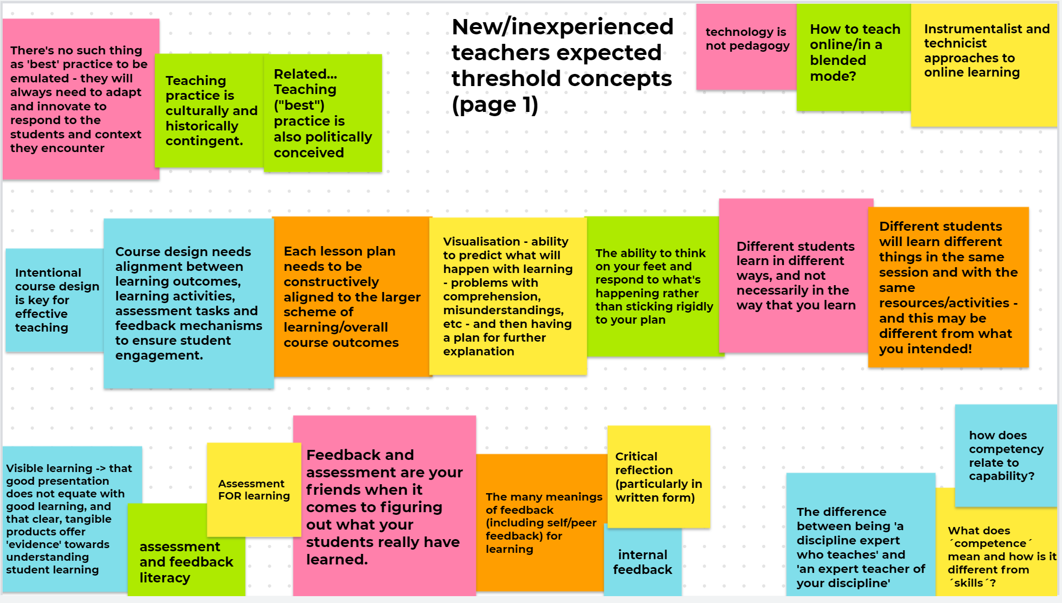
TCs for new/inexperienced teachers
crowdsourced Jamboard about TCs for new/inexperienced teachers

Slide 20
References
Ashton, S. and Stone, R. (2021). An A-Z of creative Teaching in higher Education. 2nd ed. London: Sage, pp.30-41 (D is for Design).
Davies, A. (2012) Learning outcomes and assessment criteria in art and design. What’s the recurring problem?. Networks, [online]. Available at: http://arts.brighton.ac.uk/projects/networks/issue-18-july-2012/learningoutcomes-and-assessment-criteria-in-art-and-design.-whats-the-recurring-problem
Land, R., Cousin, G., Meyer, J. and Davies, P. (2018). 'Threshold concepts and troublesome knowledge (3): implications for course design and evaluation'. In: C. Rust, ed., Improving student learning: diversity and inclusivity. [online] Oxford: OCSLD, pp.53–64. Available at: https://www.ee.ucl.ac.uk/~mflanaga/ISL04- pp53-64-Land-et-al.pdf Also available as video conference at: https://vimeo.com/91920616
Novac, K. and Bracken, S. (2019). Introduction: Universal Design for Learning, a global framework for realizing inclusive practice in Higher Education. In: S. Bracken and K. Novac, ed., Transforming Higher Education through Universal Design for Learning. Oxon and NY: Routledge
Ordorica, A. (2019). What is learning design?. [Blog] Teaching Matters Blog, Available at: https://www.teaching-matters-blog.ed.ac.uk/what-is-learning-design/
Tsang, A., (2011). Students as Evolving Professionals: Turning the hidden curriculum around through the threshold concept pedagogy. Transformative Dialogues: Teaching & Learning Journal, [online] 4(3), pp.1-11. Available at: https://twww.kpu.ca/sites/default/files/Teaching%20and%20Learning/TD.4.3.9_Tsang_Students_as_Evolving_Professionals.pdf
Get in touch on Twitter @VirnaRossi

