Slide 1


Educational Developers Thinking Aloud
Speakeasy 2: Wu Wei Learning and Teaching
Thursday, January 21st
Charlie Reis, Educational Development Unit, Xi’an Jiaotong-Liverpool University
charlie.reis@xjtlu.edu.cn
Notes:
Image: https://stock.adobe.com/hu/search/images?k=creation+of+adam+hands; 30 minutes

Slide 2
welcome
Questions we will explore together are:
What is wu wei?
Why is wu wei worth thinking about for active learning and learning design?
How can we ourselves be more wu wei?
How can we help staff implement wu wei in their pedagogies?
Notes:
For anyone looking at this later, this ppt was designed to support a one-hour, interactive, online group chat to help our staff with the fundamentals of teaching online.

Slide 3
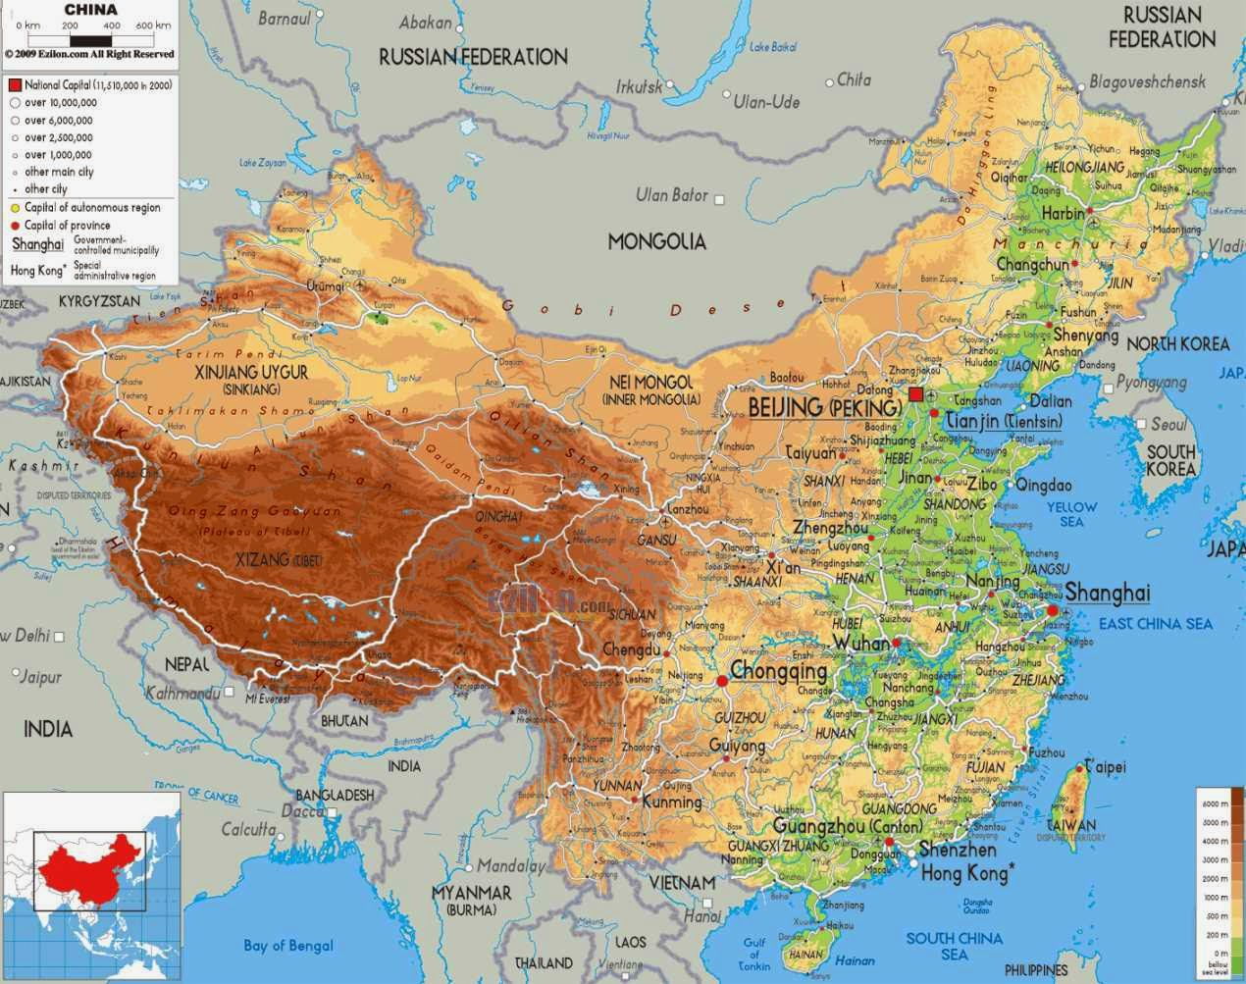
http://www.ezilon.com/maps/asia/china-physical-maps.html
Notes:
Suzhou is on the breast of the chicken. Being at a school with UK QA in China permeates everything I do as an educational developer.

Slide 4
Who am I
I am Charlie Reis, charlie.reis@xjtlu.edu.cn, Director of Educational Development Unit at Xi’an Jiaotong-Liverpool University (XTJLU) in Suzhou.
Charlie Reis FHEA
Director PGCert
Acting Director EDU
SHED/SEDA/HEA
Founder CAPED
My Work:
Classical Chinese knowledge in HE L&T
Motivation/Engagement
TNE
Sinofuturism/Sci-fi
Expertise
More importantly, my students started calling me ‘the wu wei teacher’ because they thought I was so lazy!

Slide 5
Wu Wei
圣人处无为之事 The sage handles affairs by Non-doing (wu wei),
行不言之教 And practices teaching by not speaking.
万物作而弗始 He lets all things happen but does not initiate,
生而弗有 Lets them grow but does not possess,
为而弗恃 Gets things done but does not take advantage,
功成而弗居 Achieves his goal but claims no credit.
夫唯弗居 Just because he claims no credit,
是以不去 His credit does not go away.
Wu, C (2016) THUS SPOKE LAOZI: A New Translation with Commentaries of DAODEJING . University of Hawai‘i Press: Honolulu. P.7.
Notes:
Wu, C (2016) THUS SPOKE LAOZI: A New Translation with Commentaries of DAODEJING . University of Hawai‘i Press: Honolulu.
无为 Wuwei (Non-doing) 2, 3, 10, 29, 37, 38, 43, 48, 57, 63, 64 CH. 2

Slide 6
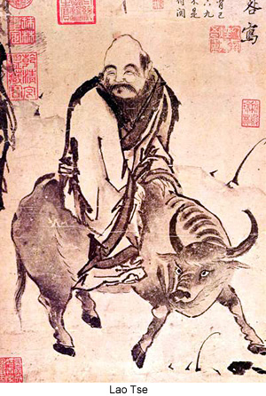
Wu Wei
Wu wei is a Daoist concept translated in many ways, such as:
doing nothing (Graham, 1989);
nonaction (Moon 2015);
non-doing, inaction (Phillips, 2015);
having no activity (Wang, 1997);
spontaneity (Keping, 1998);
non-purposive action (Schwartz, 1985);
effortless flow (Slingerland, 2017).
I think of it as ‘doing without doing’ from the perspective of students, or ‘purposeful inaction’ in the context of my organising learning. Moeller (2006) writes: wu wei er wu bu wei nonaction/but nothing is undone.
Notes:
“Nature does not hurry, yet everything is accomplished.” Fearlessness.
https://truthbook.com/urantia-book/paper-94-the-melchizedek-teachings-in-the-orient
Slingerland, Edward (2007). Effortless Action: Wu-wei As Conceptual Metaphor and Spiritual Ideal in Early China. Oxford; New York: Oxford University Press.
Moon, Seungho (2015) Wu Wei (non-action) Philosophy and Actions: Rethinking ‘actions’ in school reform. Educational Philosophy and Theory. 47 (5) pp. 455-473.

Slide 7

Wu Wei
Wu wei is a Daoist concept translated in many ways, such as:
purposeful inaction (Moon, 2015);
non-interference (Kirkland, 2001);
effortless action, perfected action, acting without acting, acting without purpose, no doing/effort/exertion, no-self (Slingerland, 2000);
non-deliberative doing (Chai, 2014);
working to align with the Will of the Way (Tadd, 2019).
“[M]ost scholars agree, the maxim of nonaction does not mean that nothing is done or that nothing ever happens in the human realm. It rather expresses the paradoxical idea that greatest efficacy is achieved by non-interference or by allowing all events and all activities to unfold naturally and unimpeded.” (Moeller, 2015)
Notes:
“Nature does not hurry, yet everything is accomplished.” Fearlessness.
https://truthbook.com/urantia-book/paper-94-the-melchizedek-teachings-in-the-orient
Slingerland, Edward (2007). Effortless Action: Wu-wei As Conceptual Metaphor and Spiritual Ideal in Early China. Oxford; New York: Oxford University Press.
Moon, Seungho (2015) Wu Wei (non-action) Philosophy and Actions: Rethinking ‘actions’ in school reform. Educational Philosophy and Theory. 47 (5) pp. 455-473.

Slide 8
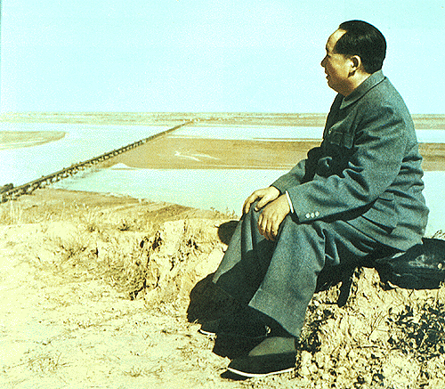
Doing without doing/purposeful inaction
During a unit on Daoism, my students dubbed me the wu wei teacher because they couldn’t believe I was so lazy.
Faced with students expecting to ‘learn’ passively, I teach by doing nothing (as little as possible), forcing students into roles of self-actualised, active learners.
Partnership and student self-actualisation are two possible logical conclusions of student-centredness. For student-centred active learning, partnerships, or student learning generally, the implication is the same; the students drive the focus and activity of learning. The argument, then, is what do we need to do to help staff successfully implement these pedagogies.
Notes:
“Nature does not hurry, yet everything is accomplished.” Fearlessness.
https://truthbook.com/urantia-book/paper-94-the-melchizedek-teachings-in-the-orient

Slide 9
SCL
Employment;
Research;
Self-actualisation
Unscaffolded
Wu wei learning and teaching
Student-staff partnership;
Research-led learning
Traditional learning; ‘banking’ model
Scaffolded
Passive
Active
I conceive of pedagogical ideas like wu wei teaching as being necessary for whatever the logical conclusions of student-centred learning is.
Notes:
“Nature does not hurry, yet everything is accomplished.” Fearlessness.
https://truthbook.com/urantia-book/paper-94-the-melchizedek-teachings-in-the-orient

Slide 10
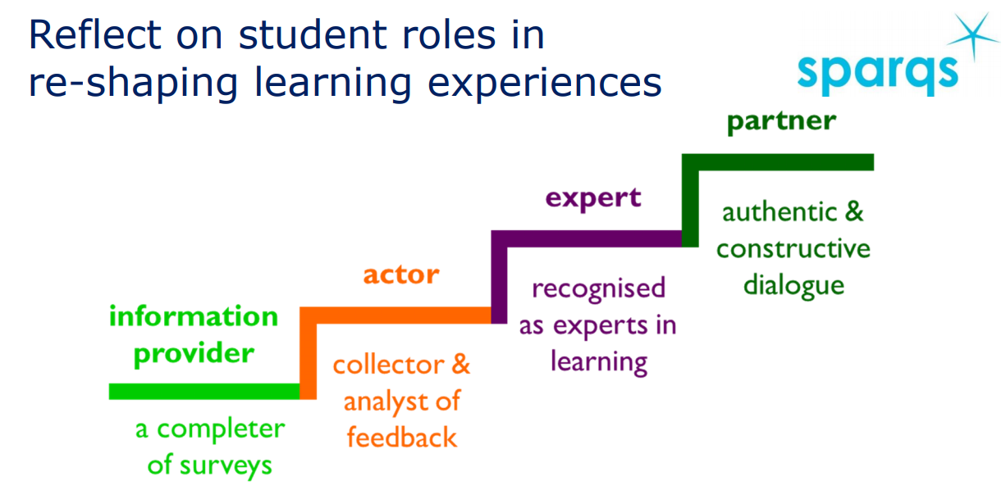
Simon Varwell’s sparqs staircase
(Varwell, 2020)
To ‘ascend’ to better pedagogy, how do we reconceive of and explain development and traditional roles in HE?
Notes:
“Nature does not hurry, yet everything is accomplished.” Fearlessness.
https://truthbook.com/urantia-book/paper-94-the-melchizedek-teachings-in-the-orient

Slide 11
Wu Wei and Rulers in Daoist Thinking
“In the Daodejing, as well as in texts associated with the Huang-Lao Daoism of late Warring States and early Han times, the notion of wu wei is first and foremost a political maxim that a ruler should adopt when trying to fulfil his primary task, namely bringing “order” (zhi 治) to his state and to the world. Chapter 3 states most succinctly: “Enact non-action, and nothing will not be in order.” (wei wu wei, ze wu bu zhi 為無為,則無不治)”
(Moeller, 2015)

Slide 12
Wu Wei and Rulers
Chapter 64 addresses the correct attitude toward desire: yu bu yu 欲不欲, meaning that we should desire to be without desires – is the ideal state, then, one wholly without desires? In what way does the absence of desire promote the well-being of the people? chapter 57 says that the ruler’s being without action and desire causes people to simplify and order themselves:我無為,而民自化. . . . . . 我無欲,而民自樸. (Blake, 2015)
To the extent that we can explain the efficacy of non-action, it lies in the comprehension of the Dao that is made possible by the space within which desires are cleared away. For learning and teaching, this means letting go of strong positions of social organisation – ‘knowledge’ is not ‘loose’ as such, but roles are.

Slide 13
Ziran
Ziran is the way the world unfolds; it is self-generated or emergent. Ames and Hall (1995) call this an acosmotic beginning, nature just has a nature, a self-so.
it-self-becoming; it-self growing; it-self-so-ing, nature, spontaneity (Wang, 1997)
‘what is so of itself’ or ‘so-in-and-of-itself’ (Coutinho, 2014, p. 74; Liu, 2015, p. 73; Slingerland, 2003, p. 97);
Moeller (2015) points out that chapter 25 of the Daodejing, ends with the line “the dao follows its self-so as a rule” (dao fa ziran 道法自然), implying that this is a larger universal principle of all nature; however, the text beings with beings.
Notes:
“Nature does not hurry, yet everything is accomplished.” Fearlessness.
https://truthbook.com/urantia-book/paper-94-the-melchizedek-teachings-in-the-orient

Slide 14
Ziran
Ziran is also the self-so of not just Being, but beings.
so-of-itself (Slingerland, 2003, p.14), or the nature of something;
the spontaneous action of a thing that originates from that thing’s own nature, not caused by factors external to it/alien to its nature (Coutinho, 2014, p. 74; Slingerland, 2003, p. 97).
The acting out of the nature of an actor/thing.
“For instance, a butterfly manifesting ziran is simply acting out its being-a-butterfly, and it is in this natural activity that Dao consists” (Maria, 2017).
Notes:
“Nature does not hurry, yet everything is accomplished.” Fearlessness.
https://truthbook.com/urantia-book/paper-94-the-melchizedek-teachings-in-the-orient

Slide 15
Ziran in Systems
According to a Daoist notion of how things naturally function, there are implications for how learning and teaching should go.
“Nature and “civilization,” the universe and society, function best if they function like a perpetual motion machine, a machine that follows its own course without the input of any external energy or the loss of energy due to internal friction. Any mechanism that is dependent on an external source of energy, on a cosmic battery, so to speak, will expire along with its battery. Only the self-sustained mechanism that is totally immanent can be absolutely free of exhaustion. If an organism is totally closed and “self-so” it cannot “leak.” Its power or efficacy is unobstructed.”
(Moeller, 2006, p. 49)
Notes:
“Nature does not hurry, yet everything is accomplished.” Fearlessness.
https://truthbook.com/urantia-book/paper-94-the-melchizedek-teachings-in-the-orient

Slide 16
Ziran and Learning and Teaching
“The spontaneity that ziran connotes though should not be understood as unbridled freedom to act out of whim. Rather, ziran means having sensitivity and responsiveness to others and to one’s environment (Lai, 2007, p. 334).” (Maria, 2017).
Ziran is here about the nature of students. How can we plan adequately for learning if planning gets in the way of learning?
The notion is the nature of the students (ziran) needs to be allowed to take its natural course in order for the student to realise her nature.
Therefore, the notion also implies agile planning and outcomes to allow the learner to unfold.
Notes:
“Nature does not hurry, yet everything is accomplished.” Fearlessness.
https://truthbook.com/urantia-book/paper-94-the-melchizedek-teachings-in-the-orient

Slide 17

Wu Wei, Ziran and Laurillard
The more we think about learning and design, the more we need to think about the limits of design or how not to overdesign. If you want a German alternative to wu wei, I offer two:
Gelassenheit or waiting/non-purposive thinking (Heidegger, 1966);
Weniger ist Mehr or less is more (Galloway, 2016 attributed to van de Rohe, 1929).
The general idea is the same. If the teacher takes up all the space, where and how does the student fit in?

Slide 18
Wu Wei and Practical Wisdom in HE
“’Wu wei’ … refers not to what is or is not being done but to the phenomenological state of the doer. As Pang Pu notes in his discussion of wu wei, the term denotes ’not a basic form of action, but the mental state of the actor—the spiritual state (jingshen zhuangtai) that obtains at the very moment of action’ (1994: 15).”
(Slingerland, 2000, p.7)
For our purposes today, wu wei can be thought of as the embodiment of practical wisdom for noninterference: knowing when to let things be or when you (staff) need to be still in order to learning to take place.
Notes:
However, the notion that this is always a phenomenological awareness is problematic.

Slide 19
You bu yu
An interesting interpretive possibility in early Chinese grammar is to read desire yu 欲 as being ambiguous in its verbal uses—that we do not consistently read yu where it serves as a verb as meaning “to desire,” but that in some places we read it as “to regard as desirable” or “to deem to be desirable.” This alternative will allow us to acknowledge the sage’s desires, without attributing to him the stronger thought that what he desires is desirable. This attitude reflects the equanimity the sage is supposed to have with regard to his desires. (Blake, 2015)

Slide 20
Wu Wei and Flow
“By embracing the characteristics of Dao (emptiness, stillness, and quietude) and its virtue of non-deliberative doing (wu wei), these detrimental values are subsequently transformed into interchangeably complimentary ideals of cosmic harmony, which is why the Daodejing says: ‘Being and nonbeing give birth to one another, so too does the hard and easy, the long and short…’ Ch. 2. By portraying ontic pairs such as these as interdependent, Daoism alleviates our fear of one term by showing how it naturally transforms into the other and vice-versa.” (Chai, 2014)
In short, purposeful inaction is linked to natural flow.

Slide 21
Can this be Positive Cultivation?
Could we realistically expect our students to suddenly understand wu wei and ziran in order to engage in learning according to a Daoist model? Might it not take some convincing?
“The Daodejing proclaims what may be called a ‘negative cultivation’ of human knowledge. It advises its intended audience (actual or prospective rulers during the historical era of its composition) to refrain from developing a specific understanding, or, in contemporary terms, a specific interpretation of the world.” (Moeller, 2015)

Slide 22
Can this be positive cultivation?
more concretely, advocates a minimization of knowledge (“To know not-knowing is the highest.” zhi bu zhi shang 知不知 上, chapter 71). It proposes to engage in a process of unlearning. Chapter 48 says: “One who engages in learning increases daily. One who hears of the dao diminishes daily.” (wei xue ri yi, wei dao ri sun 為學日益,為道日損).
(Moeller, 2015)

Slide 23
The Doing in Not-doing
Considering these, how do the Daoists propose to achieve the state of ziran? The answer is wu-wei (無爲), a word which literally means ‘no action’. Wu-wei however means more than doing nothing. Rather, it is an activity that disabuses a person of the effects of artifice and convention. To further clarify this concept, I will borrow from Slingerland’s classification of wu-wei into the behavioral and cognitive aspects (2003, p. 89). Behavioral wu-wei may be defined as ‘a form of interaction that optimally minimizes interference and allows phenomena to manifest in accordance with their natural tendencies’ (Coutinho, 2014, p. 74). This entails that human beings refrain from imposing artifice upon natural things so as to ensure the latter’s continuing development. In the Daodejing and Zhuangzi, this is often framed in terms of rulers not establishing artificial rules and values so as not to disturb the people’s natural disposition (Wu, 1961, pp. 132–139; Ziporyn, 2009, pp. 50–51). However, more essential than behavioral wu-wei is its cognitive counterpart. Indeed, cognitive wu-wei is arguably wu-wei in its primary sense. To understand this, a brief explanation of the character ‘wei (爲)’ in ‘wu-wei’ is necessary. According to Chad Hansen, the word ‘wei’ in its second tone is often understood as ‘to act’, which contributes to the understanding of wu-wei as ‘no action’ (Hansen, 2003, p. 784). However, the same ‘wei’ can also mean ‘to deem’ something as such-and-such (2003, p. 784). Hansen says that, in the context of the Daodejing, to ‘wei’ something primarily means deeming and treating it according to the significance given to it by social convention. Conversely, to ‘wu-wei’ means to disregard the contrived significance that social convention imputes upon things (Hansen, 2003, p. 785). Other scholars such as Lau, Slingerland, and Lai agree with Hansen on the cognitive conception of wu-wei and its primacy (Lai, 2007, pp. 333–334; Slingerland, 2003, pp. 79–81). For instance, Slingerland says that the word ‘wei’ in the Daodejing can mean ‘to regard’ something.4 Regarding in turn is defined by him as ‘making normative, not merely definitional, distinctions—to hold something in (high) regards. Such a regarding causes a person to value one thing over another, and therefore provides ulterior motives for action’ (2003, p. 79). Slingerland’s definition of regarding is similar to Hansen’s deeming, and it also clearly spells out the reason for the primacy of cognitive wu-wei. Since regarding is what foments desire, and since desire in turn is what leads to action, then it is by dispelling regarding—that is to say by practicing cognitive wu-wei—that artificial desires, actions, and their harmful effects are ultimately eliminated.
Notes:
“Nature does not hurry, yet everything is accomplished.” Fearlessness.
https://truthbook.com/urantia-book/paper-94-the-melchizedek-teachings-in-the-orient

Slide 24
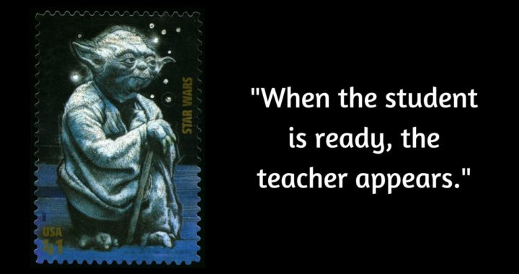
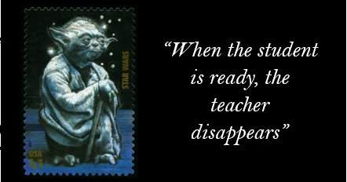
Getting to Wu Wei in a Chinese Context
From cooperative critical thinking to self-actualisation.
Why did this work?
“When the student is ready, the teacher will appear,” is a gnomic quote variously attributed to Asian thinkers.
http://startoverhere.com/mentors/
Notes:
The evolution of wu wei came from a learning model of cooperative learning where students had individual ownership of similar, teacher-supplied content with an eye towards offering an analysis that was synthesised as a group based to better form concepts to use on course their individual assessments. Since I did find this exact model in the literature, I call it cooperative critical thinking. This actually arose from practice, not theory, because I had a small group and many readings I wanted to expose them to. It was a mechanism to maximize content without over burdening students. The next semester, I started to reflect on scaffolding for students and wondered why they wouldn’t be expected to self-scaffold based on a unsuccessful class session where Y3 students had problems understanding how to read and use journal articles.
On the AZ Quotes Lao Tse:
The best of all teachers is the one who helps people so that eventually they don't need him.
And
When the student is ready the teacher will appear. page:https://www.azquotes.com/author/19615-Laozi

Slide 25
Why Wu Wei? Tradition, Context and Power
A natural context is developed from the students' experiences that is personalised and relevant to them, both in terms of the model (in my case using classical Chinese knowledge to approach contemporary thinking about learning and teaching) of an educator and, more importantly, all this doing by students results in deeper learning.
This is a Chinese, but non-Confucian model, opening possibilities to phenomenologically reframe the classroom for students and staff as a place where focus, discursive power and the production of knowledge are consciously left for the student to take more ownership of.
Notes:
Csíkszentmihályi, M. (1996). Flow and the psychology of discovery and invention. New York: Harper Collins. Chicago
“Nature does not hurry, yet everything is accomplished.” Fearlessness.
https://truthbook.com/urantia-book/paper-94-the-melchizedek-teachings-in-the-orient

Slide 26
Why Wu Wei? Psychology and Flow
The deeper context gives meaning to experience and learning; although, the level of support must be within the ZPD of your students.
In the context of Csíkszentmihályi’s (1996) notion of flow, the interplay between wu wei and ziran opens space for the student to flow into, ideally so that they experience flow themselves, which is the Daoist notion of effortless action.
Notes:
Csíkszentmihályi, M. (1996). Flow and the psychology of discovery and invention. New York: Harper Collins. Chicago
“Nature does not hurry, yet everything is accomplished.” Fearlessness.
https://truthbook.com/urantia-book/paper-94-the-melchizedek-teachings-in-the-orient

Slide 27
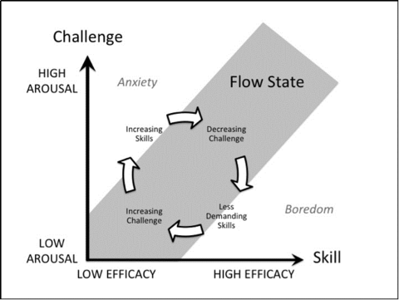
Why Wu Wei? Psychology and Flow
Oliveira, R. (n.d.) How to Foster the Flow State [online] OptimOZ: Hack Your Life. Available at: https://www.optimoz.com.au/blogs/news/174434951-how-to-foster-the-flow-state. Accessed: 30 November, 2020
According to Csikszentmihalyi (1997) the autotelic person “tends to enjoy life” and “do things for their own sake, rather than in order to achieve some later external goal”. Traits of the autotelic include: a general curiosity and interest in life, persistence, and low self-centeredness.
Notes:
Csíkszentmihályi, M. (1996). Flow and the psychology of discovery and invention. New York: Harper Collins. Chicago
“Nature does not hurry, yet everything is accomplished.” Fearlessness.
https://truthbook.com/urantia-book/paper-94-the-melchizedek-teachings-in-the-orient

Slide 28
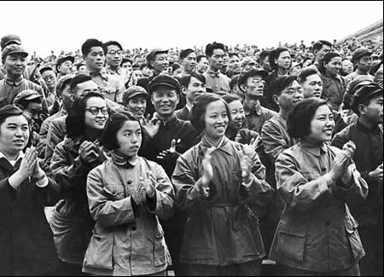
Why Wu Wei? Student Accomplishment
All courses have assessments and results; something is accomplished. This is not what the teacher has accomplished.
Why not highlight the growth and development of students as it relates to the goals and outcomes of learning, in the narrowest and broadest definitions?
The ruler rules weightlessly, he is not a burden to the ruled. When he is “in front” of the people, he does not stand in their way and does not block or obstruct their actions. (Moller, 2006, p. 59)
We could also call this student self-actualisation.
Notes:
http://usa.chinadaily.com.cn/epaper/2013-02/15/content_16224636.htm

Slide 29
Why Wu Wei? Student Peak Performance
“But we now understand that there’s no such thing as a predefined ability. The brain is adaptable, and training can create skills—such as perfect pitch—that did not exist before. This is a game changer, because learning now becomes a way of creating abilities rather than of bringing people to the point where they can take advantage of their innate ones. In this new world it no longer makes sense to think of people as born with fixed reserves of potential; instead, potential is an expandable vessel, shaped by the various things we do throughout our lives. Learning isn’t a way of reaching one’s potential but rather a way of developing it. We can create our own potential.” (Ericson & Pool, 2016. p.12)
We could also call this life-long learning for expertise.
Notes:
http://usa.chinadaily.com.cn/epaper/2013-02/15/content_16224636.htm

Slide 30

Why Wu Wei? Spontaneity
Students are free of overmuch control. They must use all their resources rather than just practising a pre-selected item or following the path – navigating the obstacles – the teacher has created for them.
This is a more spontaneous use of thought and language which forces students to use their intellectual resources to make meaning by doing something that they have ownership of.
An aspect of the non-action of the ruler is his “hiddenness.” He is as invisible as the root of a plant. Just as the root is always below the plant, he stays “under the surface” of the people. (Moeller, 2006, p.61)
This is the ‘root’ of entrepreneurialism/
career-readiness.
Notes:
“Nature does not hurry, yet everything is accomplished.” Fearlessness.
https://truthbook.com/urantia-book/paper-94-the-melchizedek-teachings-in-the-orient

Slide 31

Why Wu Wei? Authenticity
Authenticity is used differently by different writers; however, teacher inaction resulting in an authentic learning activity generally does three things:
Relates directly to the world as the students are figuring things out (knowledge and how to acquire it);
Forces students to be communicative and create language/thought/solutions;
Has meaning and objectives that are partnership-driven.
Notes:
“Nature does not hurry, yet everything is accomplished.” Fearlessness.
https://truthbook.com/urantia-book/paper-94-the-melchizedek-teachings-in-the-orient

Slide 32

Why Wu Wei? Academic identity
As the ziran of students flows into the phenomenal space of learning and teaching, they are increasingly driving the conversation in the classroom and creating knowledge, or participating in academic discourse at the appropriate level.
Conceived of as such, this makes the vision of academic identity, practice, convention and integrity a natural part of learning.
Notes:
https://www.dw.com/en/in-pictures-70-years-of-the-peoples-republic-of-china/g-50652240
“If I have seen further it is by standing on the shoulders of giants.” — Isaac Newton; Letter to Robert Hooke (5 Feb 1675-6).
Confucius:述而: Shu Er:20 子曰： 我非生而知之者，好古，敏以求之者也。 The Master said, "I am not one who was born in the possession of knowledge; I am one who is fond of antiquity, and earnest in seeking it there."

Slide 33
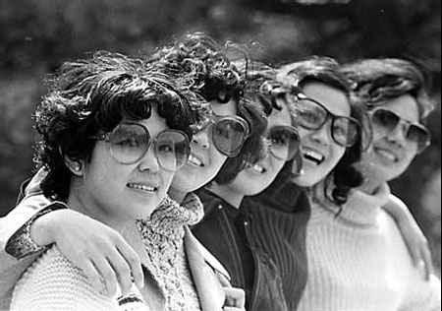
Why Wu Wei? Relevant models
Obviously, a model based on Laozi is culturally relevant to our students at XJTLU. What about other models?
What ‘model’ of education to they generally expect?
What learning behaviours does this imply?
What learning behaviours would you like your students to have?
What new or alternate models can you think of to engender those learning behaviours?
Notes:
http://usa.chinadaily.com.cn/epaper/2013-02/15/content_16224636.htm

Slide 34
Daodejing Ch. 49
圣人在天下 The sage rules this world
歙歙焉 Inhaling every breath with caution.
为天下浑其心 He tries to blur the mind of the world.
百姓皆注其耳目 People all focus on their ears and eyes;
圣人皆孩之 The sage treats them all as children.
(Trans. Wu, 2016, p. 107)

Slide 35
Daodejing Ch. 51
生而不有 Birthing but not possessing,
为而不恃 Getting things done but not taking advantage,
长而不宰 Leading but not dominating—
是谓玄德 This is called the Profound De [virtue].
(Trans. Wu, 2016, p. 111-112)

Slide 36
Daodejing Ch. 77
天之道 The way of Heaven—
其犹张弓与 Isn’t it like shooting with a bow?
高者抑之 If it is aimed too high, you lower it;
下者举之 If it is aimed too low, you raise it.
有餘者损之 If you use too much force, you reduce it;
不足者补之 If you use insufficient force, you increase it.
(Trans. Wu, 2016, p. 162)

Slide 37
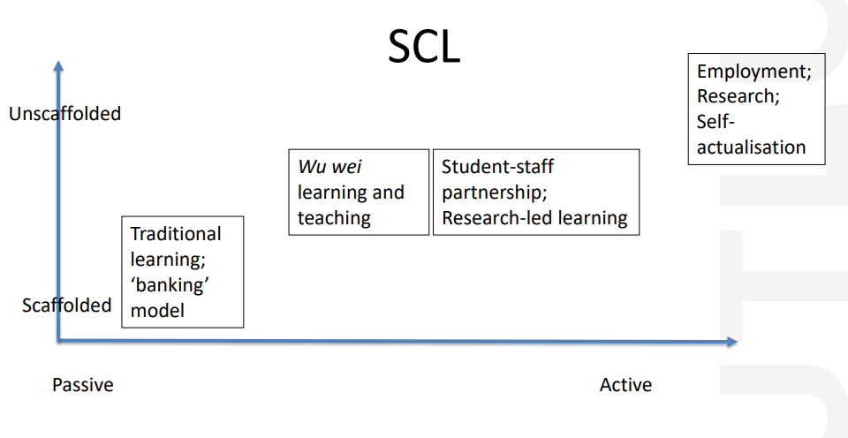
Was this a speakeasy or an opium den?
Does this work for your staff?
What would you include as principles for learning design to help staff actualise student-centred active learning?
Notes:
Wu, C (2016) THUS SPOKE LAOZI: A New Translation with Commentaries of DAODEJING . University of Hawai‘i Press: Honolulu.
无为 Wuwei (Non-doing) 2, 3, 10, 29, 37, 38, 43, 48, 57, 63, 64 CH. 2

Slide 38
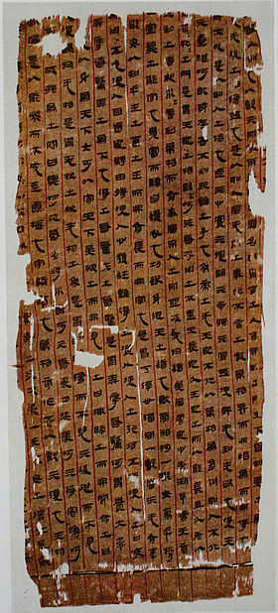

Thank you
多言数穷
不如守中
Too many words lead to quick exhaustion; Better stay centred. Dao ch. 5 charlie.reis@xjtlu.edu.cn
Notes:
https://wikivisually.com/wiki/Tao_Te_Ching
Too many words lead to quick exhaustion; Better stay centred. Dao ch. 5

Slide 39
Sources
Ames, R. T., & Hall, D. (1995). Anticipating China. Thinking through the narratives of Chinese and Western Culture. Albany: State University of New York Press.
Blake, S. (2015) AGENCY, NON-ACTION, AND DESIRE IN THE LAOZI. Journal of Chinese Philosophy 42:3–4, 284–299.
Bligh, D. (2000). What’s the use of lectures? (6th Ed.). London & San Francisco: Jossey-Bass.
Chai, D. (2014) Daoism and Wu. Philosophy Compass 9/10: 663–671, 10.1111/phc3.12171.
Coutinho, S. (2014). An introduction to Daoist philosophies. New York, NY: Columbia University Press.
Csíkszentmihályi, M. (1996). Flow and the psychology of discovery and invention. New York: Harper Collins. Chicago.
Csikszentmihalyi, M. (1997). Finding flow. New York: Basic.
Ericsson, K. A., and Pool, R. (2016). Peak: Secrets from the New Science of Expertise. New York, NY: Houghton Mifflin & Harcourt.
Freeman S. Eddya, S, McDonough, M. Smith, M. Okorofor, N. Jordt, H. Wenderoth, M. (2014). Active learning increases student performance in science, engineering, and mathematics. [Online] 10.1073/pnas.1319030111. Available at: https://www.pnas.org/content/111/23/8410.short Accessed : 12 May 2017.
Fu, C. (2000). Lao Tzu’s conception of Tao. In. J. N. Mohanty, & B. Gupta (Eds.), Philosophical Questions: East and West (pp. 49–59). Lanham, MD: Rowman and Littlefield Publishers, Inc.
Graham, A. C. (1989). Disputers of the Tao. Chicago, IL: Open Court Publishing Company.

Slide 40
Sources
Hansen, C. (1992). A Daoist theory of Chinese thought. New York, NY: Oxford University Press.
Hansen, C. (2003). Wuwei (Wu-wei): Taking no action. In A. Cua (Ed.), Encyclopedia of Chinese philosophy (pp. 785–786). New York, NY: Routledge.
Heidegger, M. (1966) Conversation on a Country Path about Thinking. In: Martin Heidegger, Discourse on Thinking. Trans. John M. Anderson and E. Hans Freund. New York: Harper and Row.
Keping:, W. trans. (1998) The Classic of the Dao. A New Investigation. Beijing: Foreign Languages Press
Kirkland, R. (2001) Responsible Non-Action in an Natural World: Perspectives from the Neiye, Zhuangzi, and Dao de jing. In: N. J. Girardot, James Miller, and Liu Xiaogan, eds. Daoism and Ecology. Cambridge, Mass.: Harvard University Press, pp. 238-304.
Lai, K. (2007). Ziran and Wuwei in the Daodejing: An ethical assessment. Dao, 6, 325–337. doi:10.1007/s11712-007-9019-8
Maria, J. (2017) Acting without regarding: Daoist self-cultivation as education for non-dichotomous thinking. Educational Philosophy and Theory, VOL . 49, NO . 12, 1216–1224.
Moller, H. (2006) The Philosophy of the Daodejing. Columbia University Press: New york.
Moeller, H. (2015) Basic Aspects of Daoist Philosophy. Academy for International Communication of Chinese Culture. 2(2):99–107 .
Moon, S. (2015). Wu Wei (non-action) Philosophy and Actions: Rethinking ‘actions’ in school reform. Educational Philosophy and Theory. 47 (5) pp. 455-473.
Oliveira, R. (n.d.) How to Foster the Flow State [online] OptimOZ: Hack Your Life. Available at: https://www.optimoz.com.au/blogs/news/174434951-how-to-foster-the-flow-state. Accessed: 30 November, 2020
Philips, M. (2015) Wu-wei as professional ethos of public service: Non-action for the 21st century. International Journal of Civil Service Reform and Practice. Vol.5. pp. 11-27.

Slide 41
Sources
Schwartz, Benjamin I. 1985. The World of Thought in Ancient China. Cambridge, MA: Belknap; Harvard University Press.
Slingerland, E. (2000) Effortless Action: Wu-Wei as conceptual metaphor and spiritual ideal in early China. New York: Oxford University Press.
Slingerland, E. (2003). Effortless action: Wu-wei as conceptual metaphor and spiritual ideal in early China. Oxford: Oxford University Press.
Slingerland, E. (2017) Trying Not to Try: Ancient China, Modern Science and The Power of Spontaneity, New York: Crown Publishers.
Tadd, M. (2019) Ziran: Authenticity or Authority? Religions. 10, 207; doi:10.3390/rel10030207
University of South Australia. (n.d.) Student-centered Learning Available at: https://lo.unisa.edu.au/mod/book/view.php?id=610988&chapterid=102030. Accessed: 30 November 2020.
Varwell, S,. (2020) Educational Developers Thinking Allowed Speakeasy 1: Students as Partners [online] Available at: https://edta.info.yorku.ca/speakeasy-1/. Accessed 9 December, 2020.
Galloway, P. (2016) Ludwig Mies van der Rohe American, born Germany. 1886–1969. [online] Available t: https://www.moma.org/artists/7166. Accessed: 21 January, 2021.
Wang, Q. (1997) On Lao Zi’s Concept of Zi Ran. The Journal of Chinese Philosophy. 24.
Wu, C (2016) THUS SPOKE LAOZI: A New Translation with Commentaries of DAODEJING . University of Hawai‘i Press: Honolulu.
Ziporyn, B. (2009). Zhuangzi: The essential writings with selections from traditional commentaries. Indianapolis, IN: Hackett Publishing Company Inc.

